Slide 1
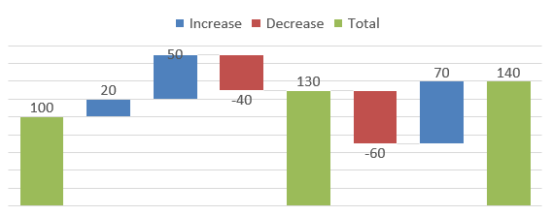
Sales Performance Dashboard
Visualizing Key Metrics in Power BI

Slide 2
Tools & Features Used in Power BI
Power BI Desktop for creating the dashboard
Excel as the data source
Bar Charts: Quantity by City
Line Charts: Quantity by Year, Sales vs Profit by City
Pie Chart: Orders by Payment Mode
Card Visuals: Total Profit, Quantity, and Order Count
Slicers for Payment Mode filtering
Power Query: Data transformation and cleaning

Slide 3
Data Preparation Process
Imported sales data from Excel into Power BI
Used Power Query Editor to clean and format data
Removed blank rows and formatted fields (Date, Profit, Quantity)
Created relationships between tables (if needed)
Loaded cleaned data into Power BI for visualization

Slide 4
Dashboard Overview
Total Profit: 756K
Total Quantity Sold: 6K
Total Orders: 547
City-wise sales and profit comparison
Year-wise quantity trend
Distribution of order payments by mode

Slide 5
Key Insights from the Dashboard
San Francisco & Buffalo lead in total quantity sold
Year 2022 recorded the highest quantity of sales
Buffalo & Rochester are high revenue-generating cities
Credit Card is the most used payment method (21.76%)
Sales declined in 2025, possibly due to seasonal or operational reasons

Slide 6
Conclusion
Dashboard enables quick tracking of sales performance
Identifies top-performing locations and preferred payment modes
Power BI allows interactive visuals and real-time data analysis
Efficient data transformation using Power Query and DAX

